Slide 1
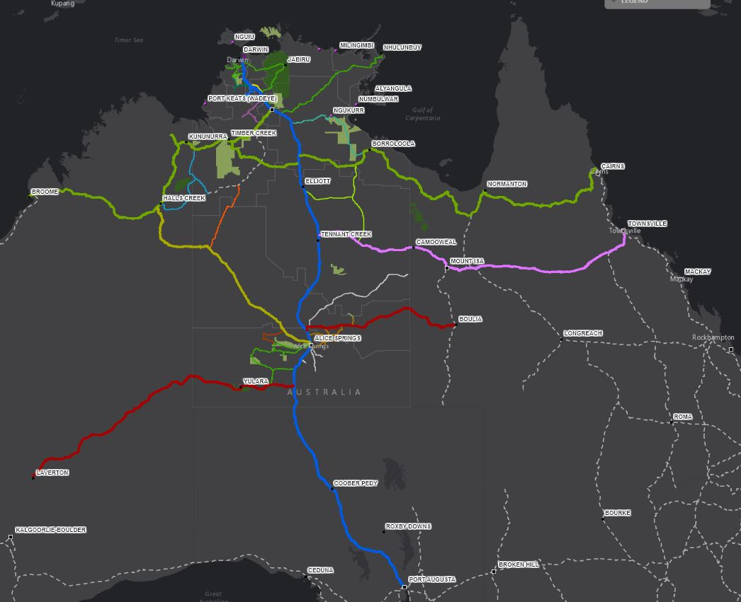
SEGRA – Barooga August 2019
Protection, Preservation, and Promotion.
Geoheritage and Geotourism opportunity in Northern Australia
Mark Asendorf
Chair Geotourism Standing Committee
Geological Society of Australia

Slide 2
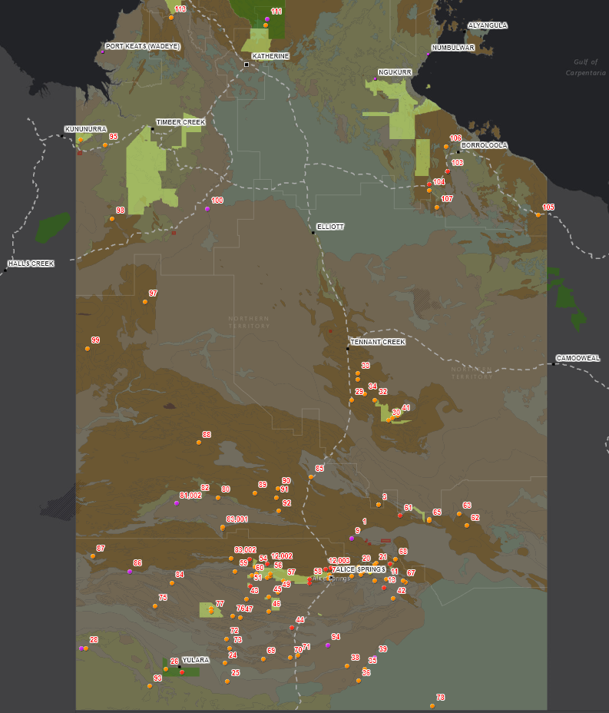
Protection, Preservation, and Promotion.
Geoheritage and Geotourism in Northern Australia
Presentation coverage:
Geoheritage NT current state & concerns
Geotourism NT current state & options
Challenges
Some lessons from Canada & Singapore
Conclusion
KAKADU
PURNULULU
RIVERSLEIGH
World Heritage
ULURU
SEGRA – Barooga - August 2019
Mark Asendorf.

Slide 3
Protection, Preservation, and Promotion.
Geoheritage and Geotourism in Northern Australia
Geoheritage.
Inadequately documented and understood.
Clustered around Central Australia
Primary source of information from 1988 GSA/NTCC publication.
Little evidence of contemporary study or analysis of geoheritage sites
NT Heritage Public Register does not reflect the sites from the 1988 publication.
Limited ‘Geoscience’-related heritage.
Significant risk to sites of importance through development or tourism activities.
KAKADU
PURNULULU
RIVERSLEIGH
World Heritage
ULURU
SEGRA – Barooga - August 2019
Mark Asendorf.
SEGRA – Barooga - August 2019

Slide 4
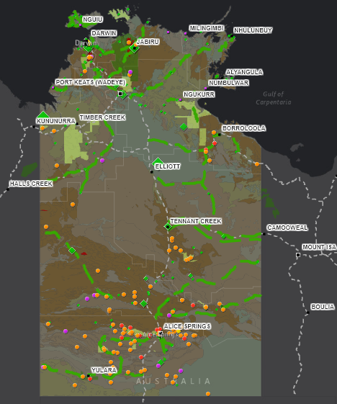
Protection, Preservation, and Promotion.
Geoheritage and Geotourism in Northern Australia
Geoheritage – why does it matter?
“Exposures or outcrops of rocks are numerous and diverse…….but surprisingly, relatively few provide outstandingly significant scientific data. The ones that do however constitute irreplaceable physical segments of Earth history.
Unlike most traits for living systems, features possessed by these monuments are not reproducible and when they are damaged or destroyed, they are lost forever”
Cowley W, 2003
KAKADU
PURNULULU
RIVERSLEIGH
…and the NT has investments in remote infrastructure in transport, housing, utilities and resource-base projects
World Heritage
ULURU
SEGRA – Barooga - August 2019
Mark Asendorf.
SEGRA – Barooga - August 2019

Slide 5
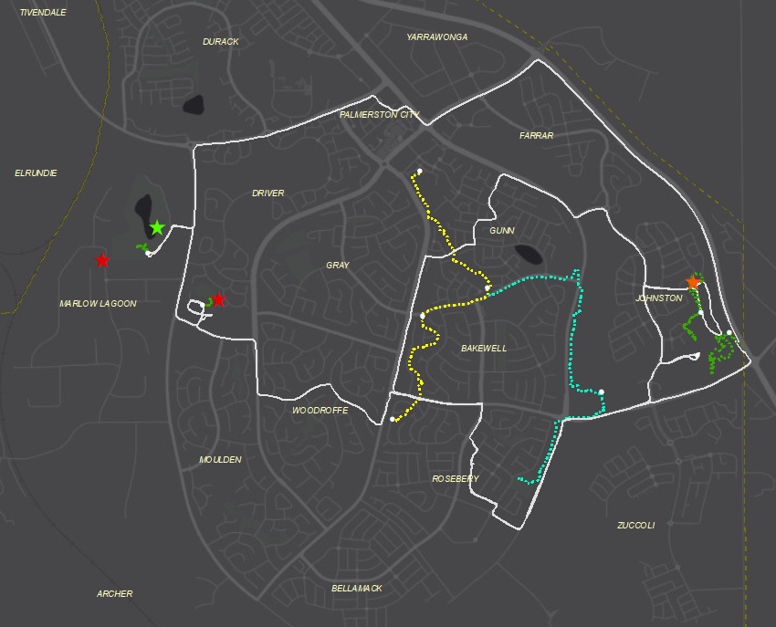
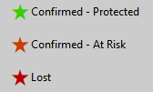
Protection, Preservation, and Promotion.
Geoheritage and Geotourism in Northern Australia
Palmerston
CBD
And….
5 significant sites around Palmerston area identified in 1980 engineering report, pre-development
Field Survey in March 2019
3 of the 5 found, 2 ‘lost’
2 protected by recreation or conservation parks
1 ‘forgotten’ amongst suburbia.
Limited/no acknowledgement of geoscientific importance
If we don’t protect it, we will loose it.
Escarpment
Trail nth
Mitchell
Creek
Escarpment
Trail sth
WW2
Heritage
Site
ULURU
SEGRA – Barooga - August 2019
Mark Asendorf.
SEGRA – Barooga - August 2019

Slide 6
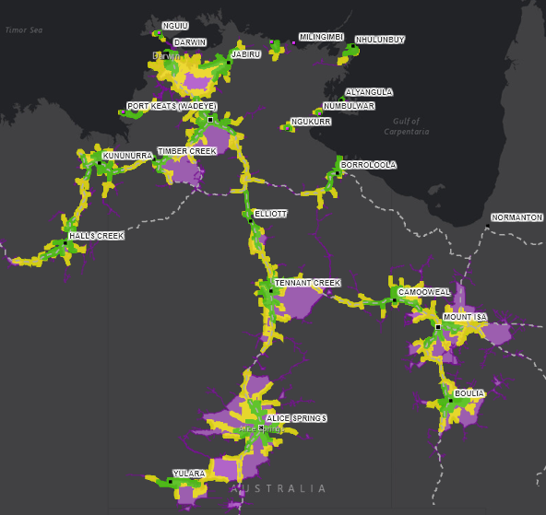
Protection, Preservation, and Promotion.
Geoheritage and Geotourism in Northern Australia
Distance, with time?
1, 2 and 4 hour driving catchments the likely transit footprint around population centers.
As expected, the Top End around Darwin and Katherine dominates.
East-West link between Tennant Creek and Mt Isa is also prominent.
And?
This may indicate elevated risks to significant geoheritage sites.
KAKADU
PURNULULU
RIVERSLEIGH
ULURU
SEGRA – Barooga - August 2019
Mark Asendorf.
SEGRA – Barooga - August 2019

Slide 7
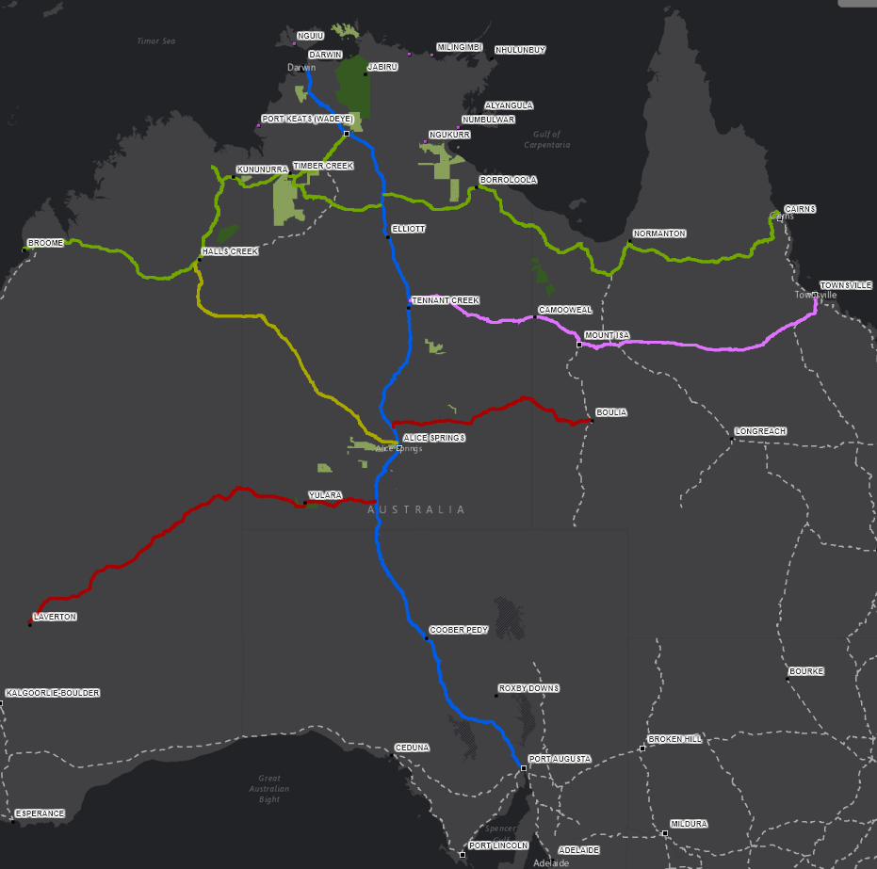
Protection, Preservation, and Promotion.
Geoheritage and Geotourism in Northern Australia
…and opportunity!
Four existing tourism routes transect the Northern Territory.
The Savannah Way – Cairns to Broome
Explorers Way – Adelaide to Darwin
Overlanders Way – Townsville to Tennant Creek
Outback Way – Winton (QLD) to Laverton (WA)
Others could be established.
“Goldrush Way” – Alice Springs to Halls Creek
Tanami upgrade indicated on the NT 10 Year Infrastructure plan.
KAKADU
KAKADU
PURNULULU
RIVERSLEIGH
PURNULULU
RIVERSLEIGH
ULURU
World Heritage
ULURU
SEGRA – Barooga - August 2019
Mark Asendorf.
SEGRA – Barooga - August 2019

Slide 8
Protection, Preservation, and Promotion.
Geoheritage and Geotourism in Northern Australia
National landscapes revisited
8 separate regions are conceptualized.
Timeless North – Tiwi/Arnhem Extensions
Big Rivers (New)
Gregory-Keep (New)
Tennant Plateau (New)
Potential Intra-state collaborations
Gulf-Isa (New – QLD/NT)
Musgraves (New – SA/NT)
Ancient Desert Rivers (SA/QLD/NT)
Firestone Plains (SA)
KAKADU
KAKADU
PURNULULU
RIVERSLEIGH
PURNULULU
RIVERSLEIGH
ULURU
World Heritage
ULURU
SEGRA – Barooga - August 2019
Mark Asendorf.
SEGRA – Barooga - August 2019

Slide 9
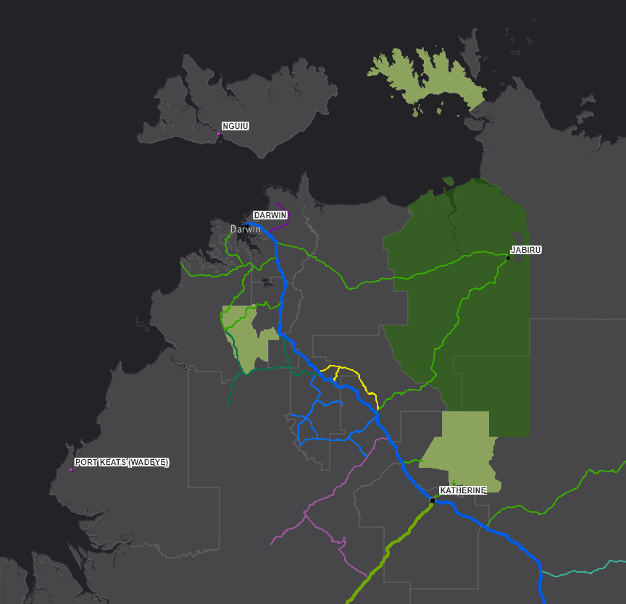
Protection, Preservation, and Promotion.
Geoheritage and Geotourism in Northern Australia
With local buy in and input.
Conceptual Top End Geotrails.
Darwin-Palmerston Discovery Trail
Southport to Pine Creek Gold Trail
Greater Litchfield Loop
Douglas Daly Explorer
KAKADU
Southport
LITCHFIELD
Pine Creek
NITMILUK
SEGRA – Barooga - August 2019
Mark Asendorf.
SEGRA – Barooga - August 2019

Slide 10
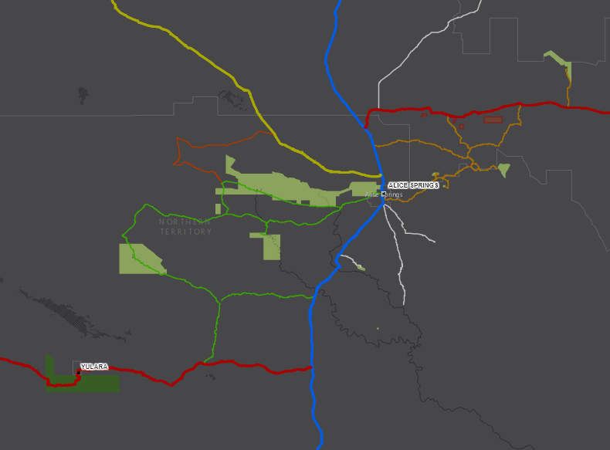
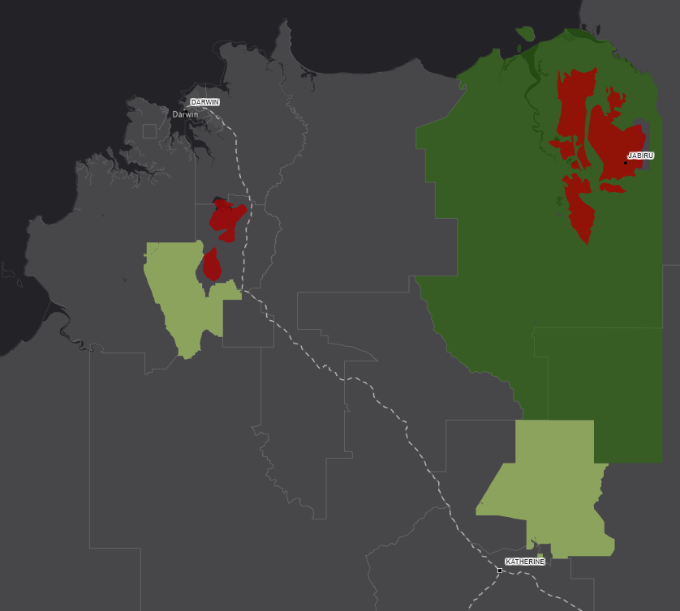
Protection, Preservation, and Promotion.
Geoheritage and Geotourism in Northern Australia
With local buy in and input.
Conceptual Centralian Geotrails.
Expansion of the existing Red Centre Way
Red Centre East (Fossickers Way?)
Eastern Amadeus landscapes and culture.
North MacDonnell
KAKADU
PURNULULU
RIVERSLEIGH
ULURU
ULURU
SEGRA – Barooga - August 2019
Mark Asendorf.
SEGRA – Barooga - August 2019

Slide 11
Protection, Preservation, and Promotion.
Geoheritage and Geotourism in Northern Australia
With local buy in and input.
Conceptual Palmerston Geotrails.
Enhancements to the Escarpment Trail
Developing Mitchell Creek Trail
Connectivity between sites and routes
Inclusion of other elements – parks, remnant forest, military heritage
Promotion
….and protection…..
Palmerston
CBD
Escarpment
Trail North
Mitchell
Creek
Escarpment
Trail South
WW2
Heritage
Site
SEGRA – Barooga - August 2019
Mark Asendorf.
SEGRA – Barooga - August 2019

Slide 12
Protection, Preservation, and Promotion.
Geoheritage and Geotourism in Northern Australia
Challenges.
Priority! - Protection and preservation of Geoheritage (GH)
General awareness of Geotourism (GT) & potential
Alternatives being supported over GH/GT
Safety – roads, remoteness, communication
Mitigation of intentional vandalism of sites, unintentional over-tourism
Establishing a common GH/GT voice across Australia
Access to sites and buy-in from:
Aboriginal / First Nations peoples
Pastoralists
Mining
Public
Government and NGO’s
Tourism Companies
?
SEGRA – Barooga - August 2019
Mark Asendorf.
SEGRA – Barooga - August 2019

Slide 13
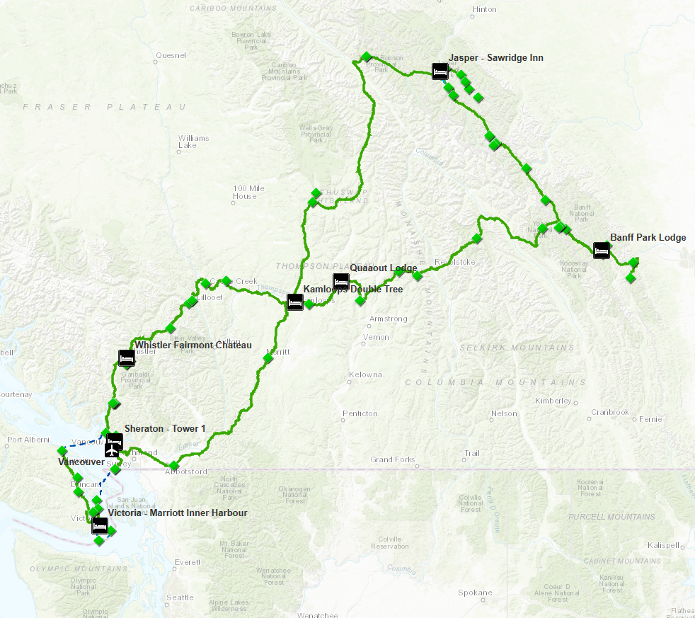
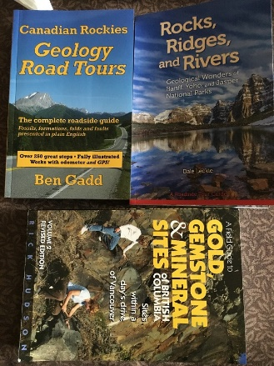
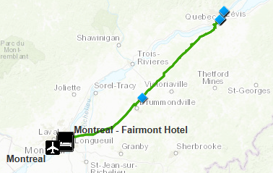
Protection, Preservation, and Promotion.
Geoheritage and Geotourism in Northern Australia
Lessons from Canada.
British Columbia, Alberta, Montreal, Quebec
“Tourist-eye” view, not GH/GT focused
1/. Integration into the holiday tour
2/. Availability of Information
3/. Influence of technology
4/. First Nations / Relationship to place
5/. Commercialisation of fossils and resources.
6/. …And did I mention the books!
ULURU
SEGRA – Barooga - August 2019
Mark Asendorf.
SEGRA – Barooga - August 2019

Slide 14
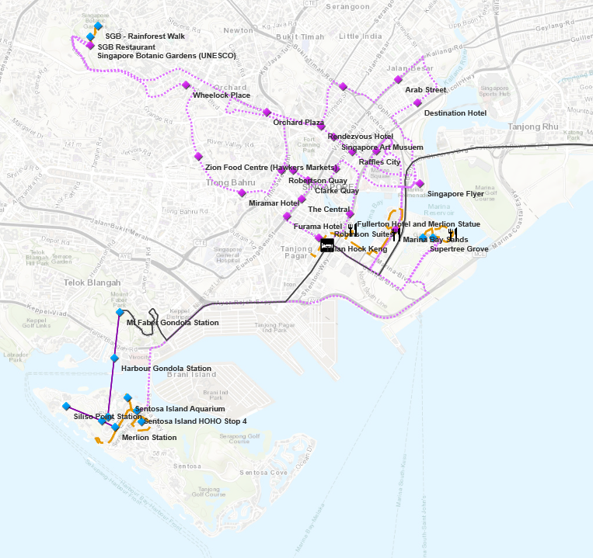
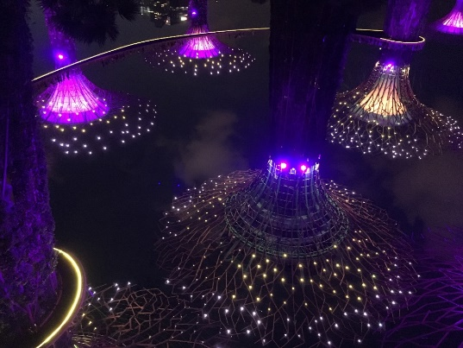
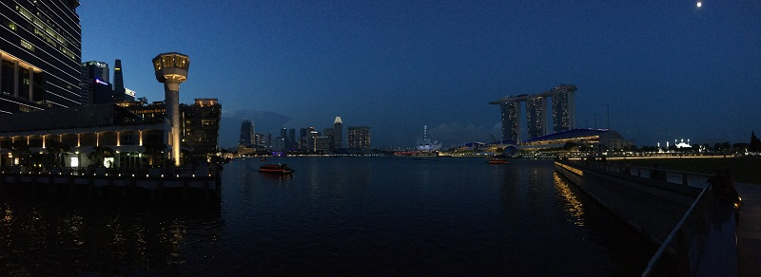
Protection, Preservation, and Promotion.
Geoheritage and Geotourism in Northern Australia
Lessons from Singapore.
Singapore CBD, Marina Bay and Sentosa Is.
“Tourist-eye” view, not GH/GT focused
1/. Celebrate of history and culture
2/. Diversify the visitor experiences
3/. ‘Tech it up’
4/. Make your own attractions!
ULURU
SEGRA – Barooga - August 2019
Mark Asendorf.
SEGRA – Barooga - August 2019

Slide 15
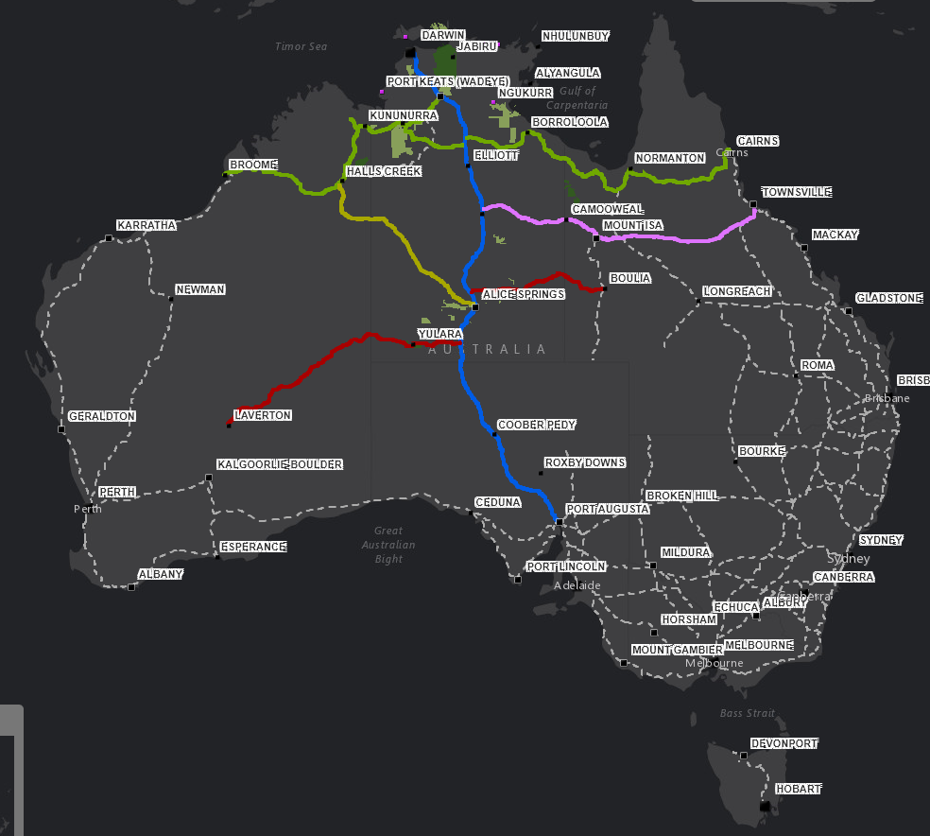
Protection, Preservation, and Promotion.
Geoheritage and Geotourism in Northern Australia
The path forward.
Contemporize our Geoheritage Registry
Engage (and energise!) the stakeholders
Establish a recognizable ‘Geo-NT’ brand
Focus on the little wins that matter.
ASPIRATIONAL GOAL - Plan and advance 1-3 NT Geotrail concepts within the year
…And collaborate with neighboring states, professional bodies and industry to progress geoheritage and geotourism across Australia.
KAKADU
PURNULULU
RIVERSLEIGH
ULURU
SEGRA – Barooga - August 2019
Mark Asendorf.
SEGRA – Barooga - August 2019

Slide 16
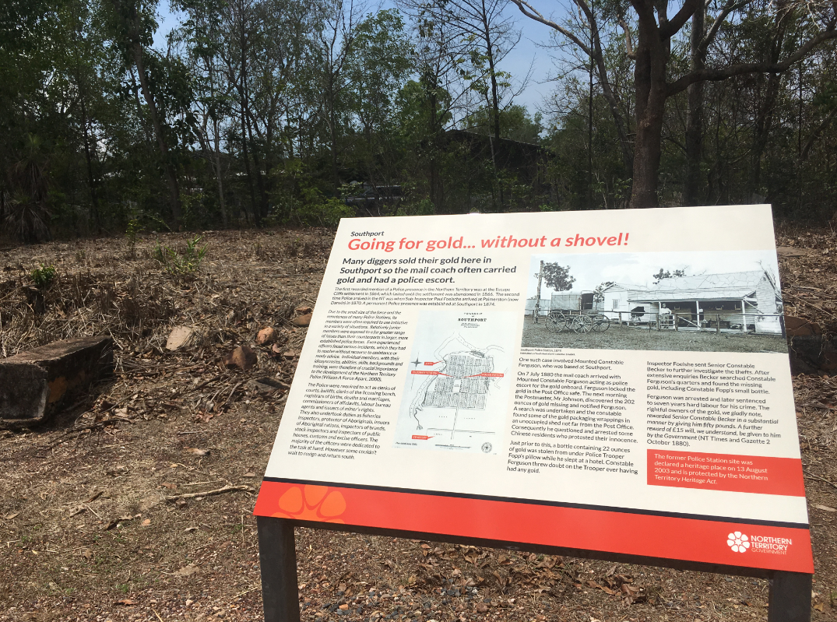
Protection, Preservation, and Promotion.
Geoheritage and Geotourism in Northern Australia
The final word.
“The geotourism movement in the Northern Territory may be a multitude of quiet voices …….or it may track faster, as more individuals and organisations see the potential and position into the industry”.
Signage at Southport
SEGRA – Barooga - August 2019
Mark Asendorf.
SEGRA – Barooga - August 2019

Slide 17
Protection, Preservation, and Promotion.
Geoheritage and Geotourism in Northern Australia
Thank You
An interactive online version
of this presentation is available at:
https://arcg.is/11DTja
SEGRA – Barooga - August 2019
Mark Asendorf.
SEGRA – Barooga - August 2019

Slide 18
Protection, Preservation, and Promotion.
Geoheritage and Geotourism in Northern Australia
Primary references and sources used for this presentation.
Broek PRV, 1980, Engineering Geology of the proposed Darwin East urban development area, Northern Territory, Bureau of Mineral Resources, Canberra.
Cowley WM (compiler), 2003, Geological Monuments of South Australia 1:2000000 scale. Department of Primary Industries and Resources SA.
Fortowski D, Crick I, Lau Geoff, 1988, The Geological Heritage of the Northern Territory, Geological Society of Australia.
Northern Territory Government (2), 2019, 10 Year Infrastructure Plan 2018 - Annual Review [Viewed 29/11/2019] https://transport.nt.gov.au/publications/10-year-infrastructure-plan-2018
Northern Territory Government (3), 2019, NT Historic Register public portal, [Viewed 11 Mar 2019] www.ntlis.nt.gov.au/heritageregister/
-----------------------------------------------------------------------------------------------------------
This presentation, diagrams, maps and online version of this presentation have been built using ESRI ArcGIS Desktop 10.5.1, 10.7.1, and ArcGIS Online (AGOL) software.
Data has been sourced and/or derived from:
1/. Geoheritage (NT) Dataset compiled from Fortowski D, Crick I, Lau Geoff, 1988, & Broek PRV, 1980
2/. Commonwealth of Australia - Collaborative Australian Protected Areas Database (CAPAD) 2016 (CCBY40) , Geodata Topo 250K Series 3 (CCBY30)
3/. Northern Territory Government (Geological Survey) - Geological Interp 2.5M (CCBY40)
4/. PSMA - Administrative Boundaries - Local Government Areas
5/. Marmel Enterprises – GPS tracks and Waypoints, personal photos
6/. ESRI - Dark grey base-map, topo base-map, & 1, 2 and 4 hour drive time catchment calculations.
A more comprehensive reference list is available at: https://arcg.is/11DTja
SEGRA – Barooga - August 2019
Mark Asendorf.
SEGRA – Barooga - August 2019

